Slide 1
Those Pesky Run-Ons

Slide 2
What is a run-on?
Seth fell, he cried.
Although the goblins of fire laughed at my weak computer skills and then stole the large block of cheddar cheese I purchased from that Cheese to Please place last Wednesday afternoon, I ended up giving them mad props for their hardcore computer knowledge as well as their odd ability to scare children when offering them lollipops and boxes of newborn puppies.

Slide 3
What is a run-on?
In fact, it only takes four words to create a run-on.
A run-on is created when two or more complete sentences are connected without the proper punctuation.
This is a complete sentence, this is too.

Slide 4
What is a run-on?
There are two basic types of run-ons.
The Comma splice . . .
Jake had a weasel on his head, he carried a pink umbrella.
A comma splice is formed when two complete sentences are joined by a comma.

Slide 5
What is a run-on?
The fused sentence . . .
Jake had a weasel on his head he carried a pink umbrella.
A fused sentence is formed when two complete sentences are joined without punctuation.

Slide 6
How do you fix it, eh?
There are four ways to fix run-on sentences.
Make two complete sentences.
Jake had a weasel on his head. He carried a pink umbrella.

Slide 7
How do you fix it, eh?
There are four ways to fix run-on sentences.
Use a semicolon.
Jake had a weasel on his head; he carried a pink umbrella.
(notice that this is now one sentence; don’t forget to observe punctuation and capitalization rules.)

Slide 8
How do you fix it, eh?
There are four ways to fix run-on sentences.
Use a comma and a coordinating conjunction.
Jake had a weasel on his head, and he carried a pink umbrella.
(Notice that this is now one sentence; don’t forget to observe punctuation and capitalization rules.)

Slide 9
How do you fix it, eh?
There are four ways to fix run-on sentences.
Turn one of the independent clauses into a dependent clause.
While Jake had a weasel on his head, he carried a pink umbrella.
(notice that this is now one sentence; don’t forget to observe punctuation and capitalization rules.)

Slide 10
Sentence or run-on?
Jerry was a racecar driver, he was 22 years old, he said, “Yes, I’m number one!”
Flipping on the switch, Robin was surprised to see Big Foot chillin’ in her bedroom, trying on her bling.
Wondering why he ever decided to jump a flight of concrete steps, Little Timmy looked sadly out the hospital window he saw many happy kids outside.

Slide 11
Sentence or run-on?
During last night’s storm, a powerful F4 tornado rocked the sprawling metropolis of Plymouth, many people lost all of their belongings, it was too bad.
Although Ross ate crumpets and cheese, he refused to eat the duck liver pate, and he opened up a bag of greasy, fattening Cheetos^{TM.}
I love comma splices they are exquisite.

Slide 12
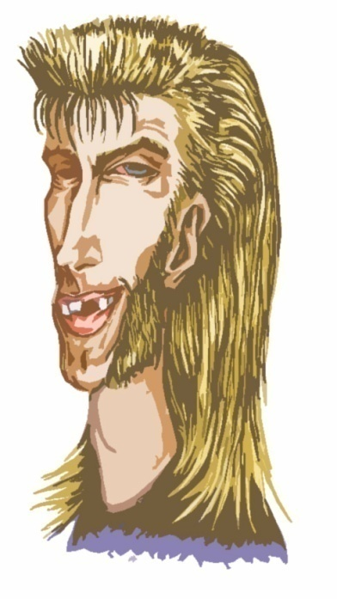
Sentence or run-on?
Dan’s mullet flapped around like a willow bough in the breeze; many ladies found the scene extraordinarily awesome because girls dig guys with 10/90 mullets.
Vanessa likes candy and slam dancing in fact, you can often find her eating skittles and slam dancing at the same time.
I ate the live cockroach it was nasty.

